Slide 1
TRICS AUSTRALASIAN DATABASE WORKSHOP
Nick Rabbets
Managing Director - TRICS Consortium Limited

Slide 2
Quick recap
TRICS & TDB working together since 2014 to have an Australasian Database
Legal Agreement Signed in April 2017
Australasian System to be separate so that data from different regions can not be combined
Phase One – System to Contain Historic TDB Data
Phase Two – System to include TRICS Methodology Surveys, in 15 minute intervals
Ongoing Survey Programme by TRICS & TDB
Notes:
A quick recap of what has been undertaken to date with regard to the Australasian Database. Since 2014 TRICS and TDB have been working together to create a siloed database for your historic data. The legal agreement was signed in 2017 which formally started the development of a two phase project. It was agreed at an early stage that the Australasian system should be siloed, this ensures that incompatible data can not be combined and also enables the database to be very much Australasian centric in its design.
Phase One of the system is to contain the historic data already contained within an Excel spreadsheet, this has been quite problematic, as the data is not in our usual TRICS format, as you will see later in this presentation.
Phase Two of the system is to be more akin to the TRICS UK system, 12 hour counts (undertaken in 15 minute intervals).
Once Phase Two has been completed there will be a continuing survey programme by TRICS and TDB to undertake TRICS surveys within the region.

Slide 3
Phase one completed
Historic TDB Data included within the Australasian Database
Extensive BETA Testing undertaken by TRICS & TDB
System Released in Australasia on 17th September 2018
Notes:
It has taken a while to get this phase completed, as the data is very different to TRICS’ standard format. Extensive Beta Testing was undertaken by TRICS and TDB to ensure that the system was working properly and that all the niggles had been ironed out and we have now got a system which uses mainly single hour surveys into a form that is more TRICSesk.
The system was released to the Australasian TDB members in September 2018.

Slide 4
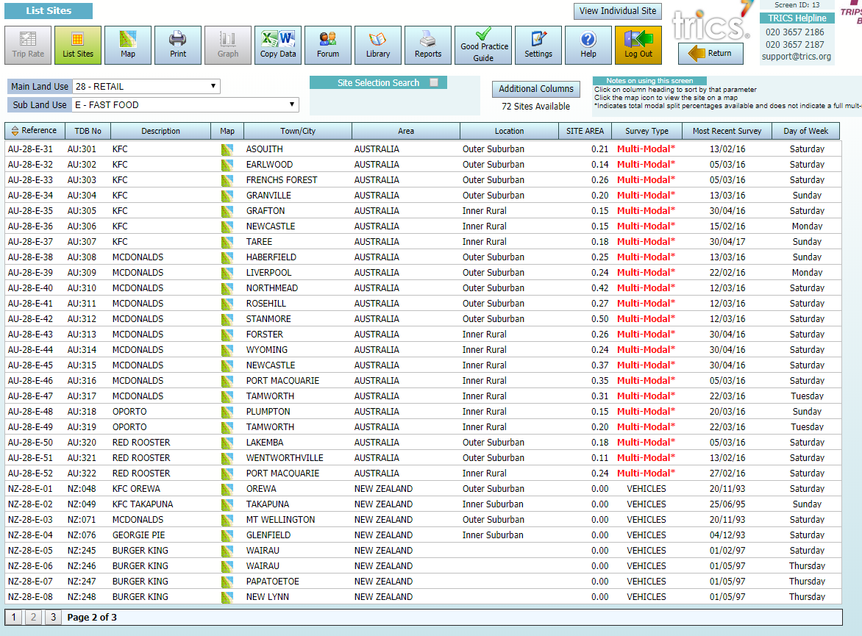
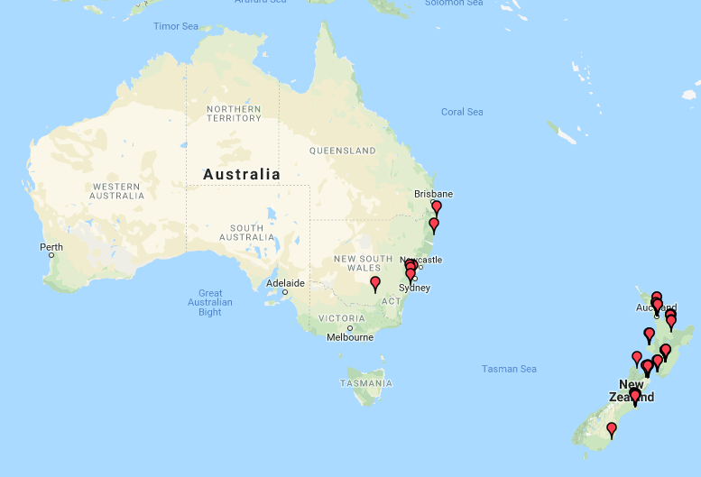
Site Selection Screens and Icons are the same within both systems
Map Feature – Showing Residential Dwellings within system. 76 Shown but looks less due to the vastness of the region.
Notes:
Quick Screen shot showing the Map feature and the location of the Fast Food sites on the system. There are actually 76 sites here, but due to the vast nature of the region covered it looks a lot less from the dots on the map. As you can see these screens are very much the same as we have within the UK system.

Slide 5
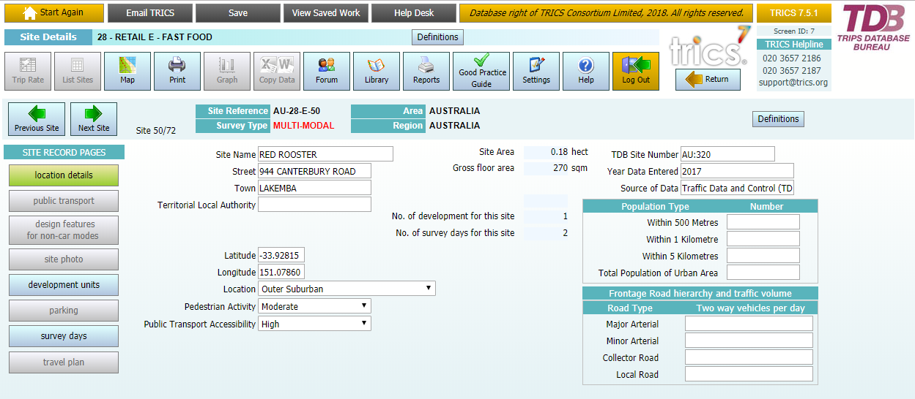
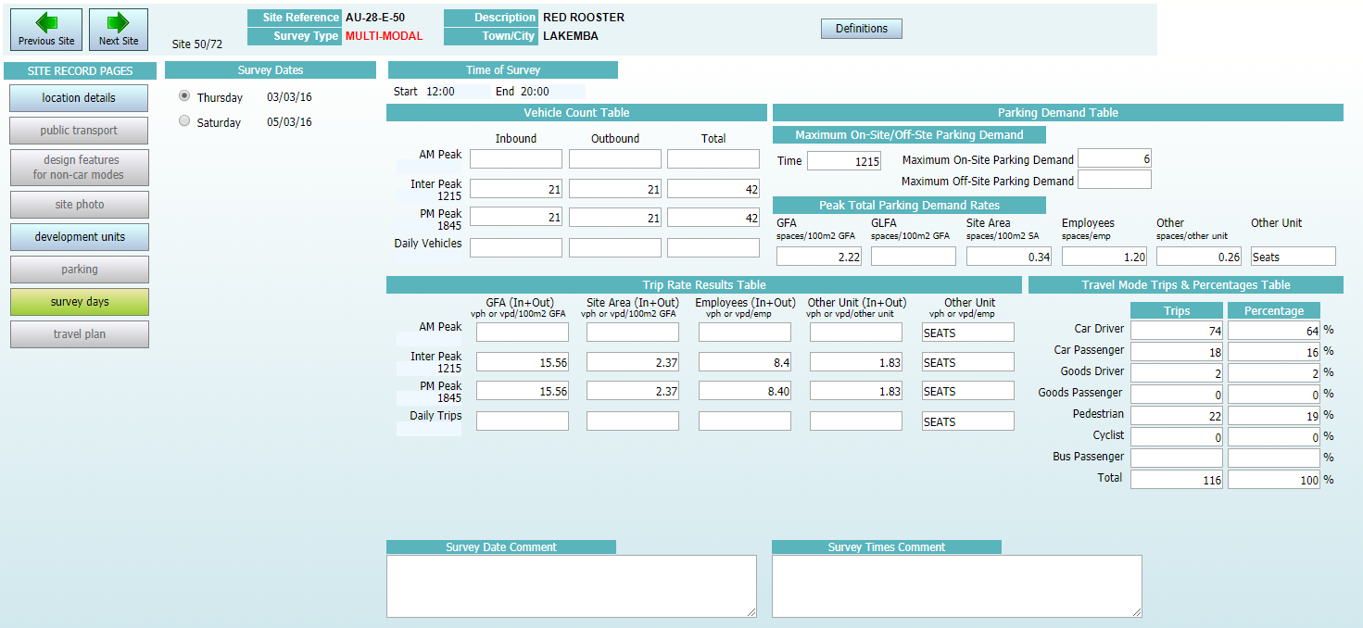
Notes:
As you can see in this Phase One System, the Location Details Screen is very similar to the UK version.
However, due to the Historic data only containing limited survey data the Survey Days screen has had to be changed so that it can handle limited data sets. Phase two of the system will contain 12 hour counts, so these sites will be more akin to the UK format.
I will be undertaking a very quick Phase One demo shortly

Slide 6
Phase two
TRICS & TDB to agree Survey Methodology suitable for Australasian Region
  This is very close to completion, with only a few points now to agree
Amend System to enable Australasian TRICS Surveys to be hosted
  The final version of the database will be very similar to Phase One, with only a few changes to ensure that full 12 hour counts can be utilised.
Undertake new Methodology Surveys
  Counts to be undertaken in 15 minute intervals with the option within the database to undertake calculations in 60, 30 and 15 minutes intervals
Release System
Notes:
As you will probably guess, although very similar in nature, the Surveys within the region will be different to the UK. Vehicle types might be slightly different, the land-uses used within the UK or not compatible to those in Australasia and different questions regarding population densities and public transport provision may be changed. However – it would appear that this part of Phase Two is very near to completion, with only a few points to agree, hopefully during my visit.
One area that is going to be trailed within the phase two system is the provision of 15 minute survey intervals.
As soon as the survey methodology has been agreed and the data upload facility has been amended to reflect the changes we will start to commission the data collection within the region.
System Release – this will very much depend upon the changes required. However, initial discussions appear to suggest that only slight modification to the already operational Phase One system is required to enable full 12 hour surveys to be available.

Slide 7

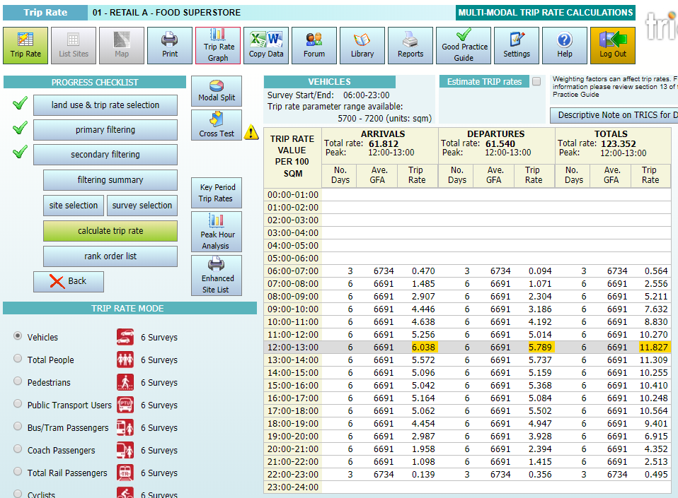
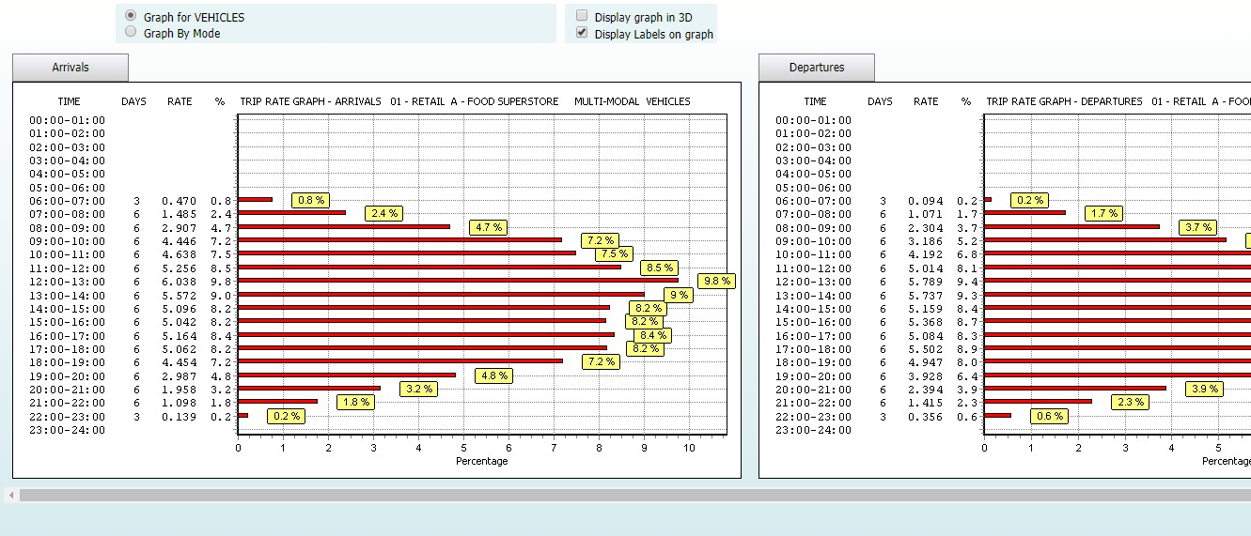
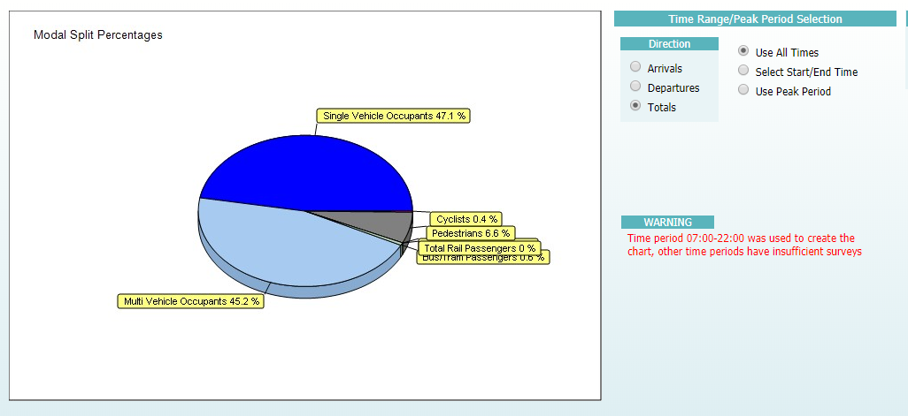
Phase two – expected changes
2
15 Mins
30 Mins
1 Hour
Notes:
So we now move to what you will be able to expect from Phase two of the system.
The main areas will not change much from the Phase one database. However, it will include the following.
12 Hour Counts – undertaken in 15 minute intervals.

Slide 8
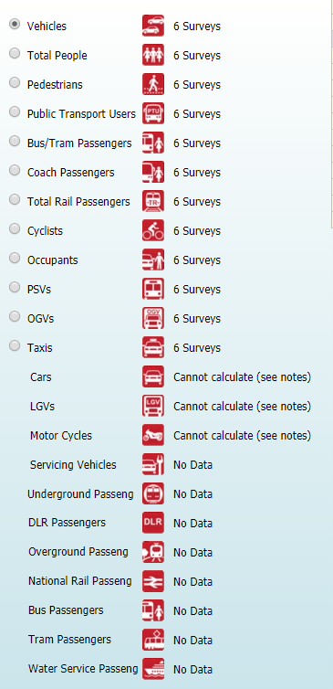
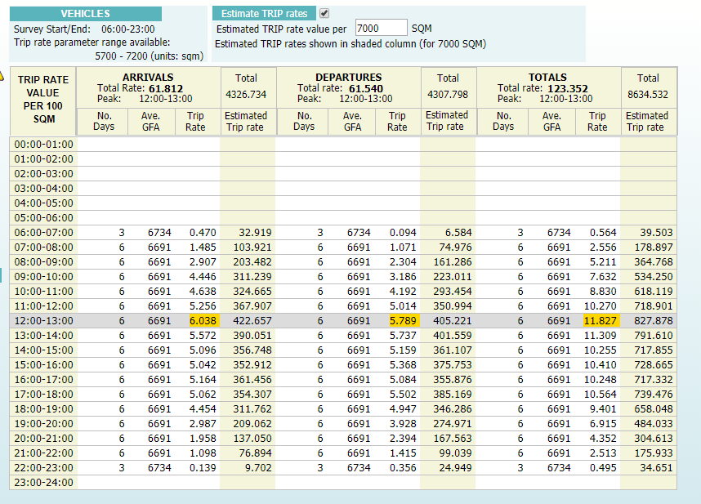
Phase two – expected changes
2
Notes:
We are intending to undertake Multi-Modal surveys within Australia and New Zealand. This slide shows how we deal with this in the UK, so it’s easy to see the types of vehicles that are now being covered within UK surveys and how you can select information from each individual main mode contained within the surveys. There will of course be differences within this area, as some of the transport modes are not the same.
By selecting the “Estimate Trip Rates” Box you can undertake a simple calculation based upon the average trip rate calculation. This facility may become extremely useful if we start to look at TRICS Exports into standard outputs for other packages, such as junction analysis tools. In this instance you will see I have input 7000 m² into the revealed box and the shaded columns show the total number of trips generated for each time period selected.

Slide 9
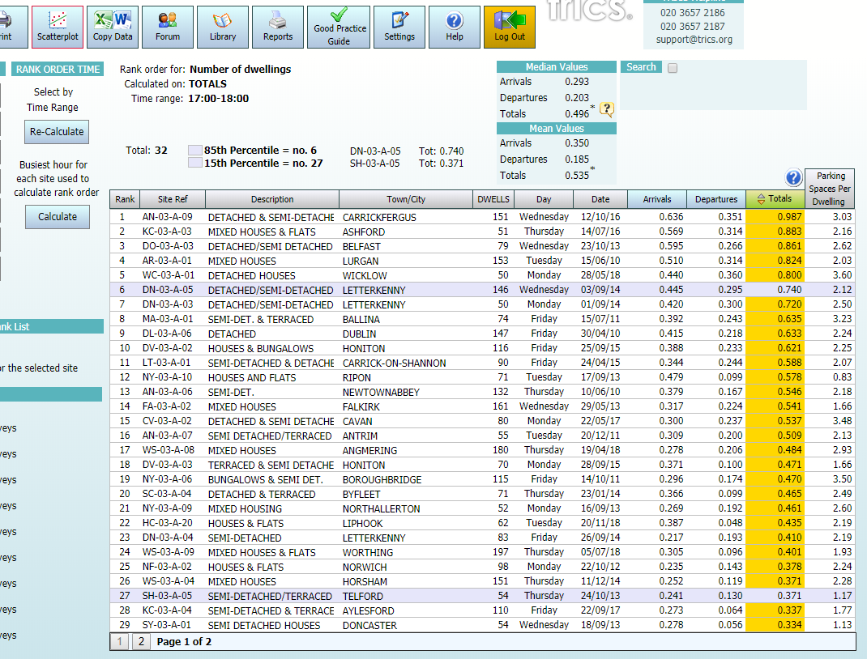
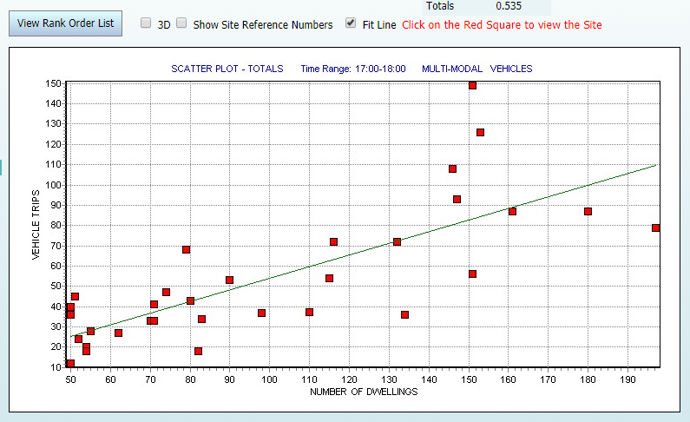
Phase two – expected changes
Notes:
Here we have the rank order list. You can select the time range for this table, IO have selected 17:00-18:00 in this instance. The yellow highlighted column shows how the sites are ordered. The two blue highlighted rows show the 15th and 85th percentile sites.
By clicking the “Scatter Plot” Icon you get the information in graph form. This enables the user to look to see how the trip rates for each site relate to each other. By clicking on one of the red dots you will be taken to the detailed site screen.

Slide 10
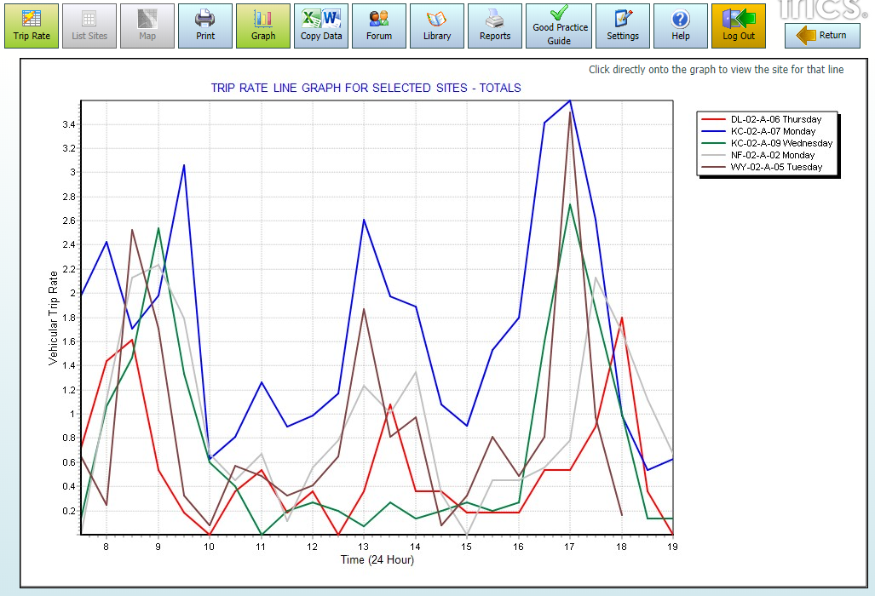
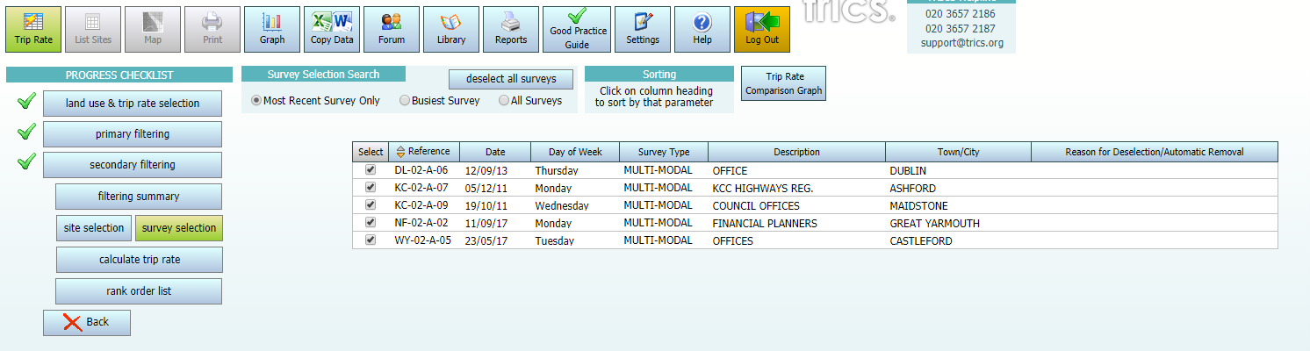
Phase two – expected changes
Notes:
So here we have the survey selection screen, where if you select “Graph” you will see how the trip rates for each site compare to each other. This is a great facility to use to see if there are any unusual sites.

Slide 11
Data collection
TDB/TRICS Survey Working Group
Devise a joint programme of surveys for 2019 & 2020
Data Collected using TRICS Australasian Survey Methodology to ensure consistency within the database.
Minimum of 12 hour counts
User feedback upon Surveys is always appreciated and can help to achieve a good survey programme
Notes:
To ensure that the regions specific needs are met TDB’s Survey Working Group will work closely with TRICS to ensure that the surveys undertaken are the most important for the region.
It is hoped that we can start to devise a programme of surveys for 2019 and 2020 to ensure that we get a good amount of data within the system as soon as possible.
12 hour counts will be the minimum undertaken, at some developments surveys may even be longer. In the UK some Food Superstores have been surveyed for 18 hours.
We hope to involve user feedback with regard to this aspect as well, so if you have ideas of particular sites or just a particular land use that you think needs specific attention please let us know.

Slide 12
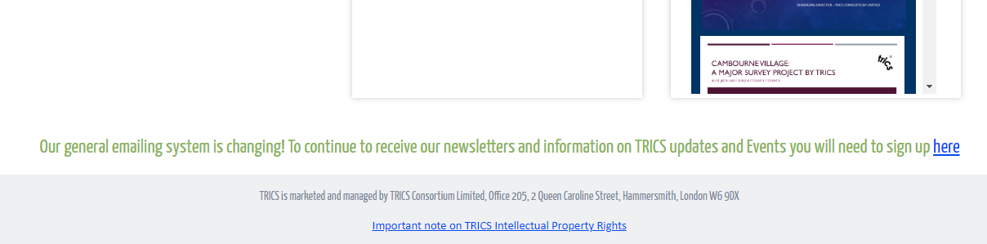
System development
The TRICS Database System has always been led by it’s users. TRICS and TDB are keen to keep this aspect within this region.
Annual User Survey sent out in March each year – need to register with our MailChimp system to ensure you receive information.
Send System Development suggestions via Annual Survey or Direct via email to us at any point.
Notes:
It is important for all users to know, that although your are on the other side of the world, TRICS looks after its users and encourages feedback and suggestions. It’s the only way we have kept the system progressing and up to date.

Slide 13
Phase one system demonstration

Slide 14
questions
Feel free to contact me direct:
nick.rabbets@trics.org
www.trics.org

